Slide 1
.NET CLI all the things!

Slide 2
CLI (Command Line Interface) tools provide power, flexibility, and efficiency

Slide 3
.NET CLI all the things!
Andres Pineda
Sr Cloud Developer
Uno Platform Core Developer
Co-host of Dotnet Dominicana

Slide 4
Agenda
01
02
03
Setup and Configuration
Basic Flow
Extending the CLI
04
05
dotnet new more targets
Build, test and release

Slide 5
The .NET CLI is a cross-platform toolchain for developing, building, running, and publishing .NET applications.

Slide 6
Installation and Setup

Slide 7

Get .NET 9
Download .NET 9 aka.ms/get-dotnet-9

Slide 8
--version --list-sdks -h or help

Slide 9
Enable Auto Complete

Slide 10
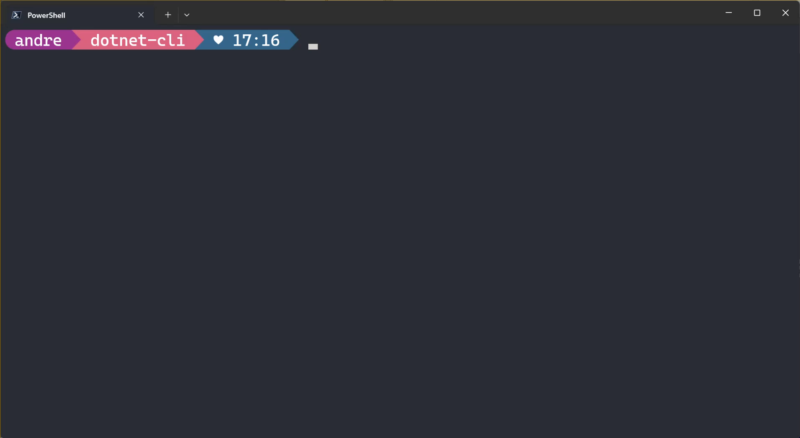
Enable Auto Complete

Slide 11
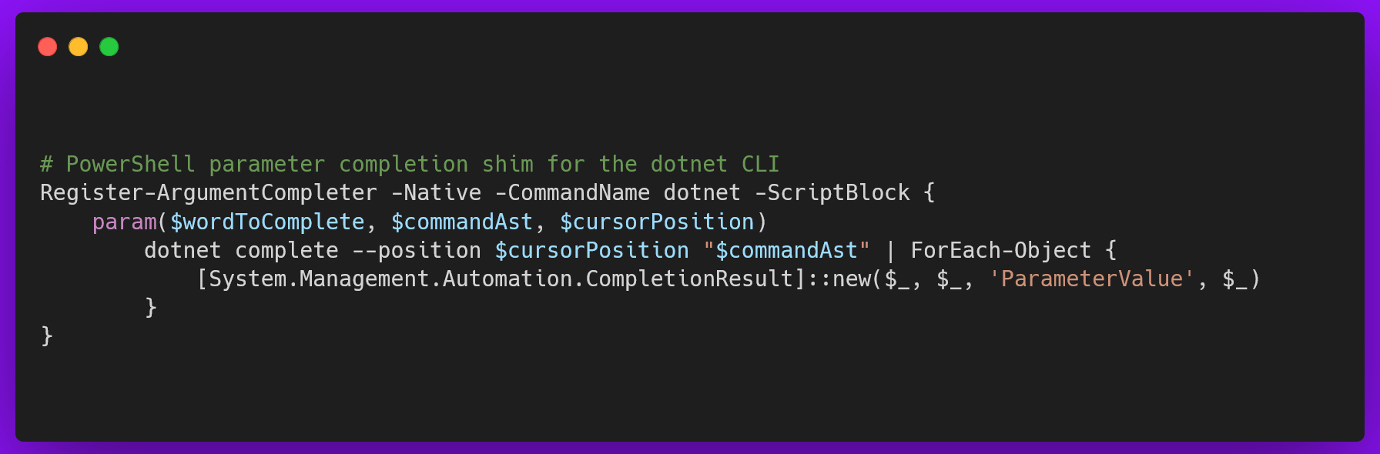

https://learn.microsoft.com/en-us/dotnet/core/tools/enable-tab-autocomplete

Slide 12
Basic Flow

Slide 13
C:\>dotnet

Slide 14
dotnet run
add build clean new run nuget test tool workload

Slide 15
dotnet run app05 –f net9.0

Slide 16
[dotnet] [run] [app05] [–f net9.0]

Slide 17
Demo: Basic Flow
create, run and manage app dependencies

Slide 18
dotnet new install
create details install list uninstall search

Slide 19
Demo: Basic Flow
Manage Custom Templates

Slide 20
Extending the CLI

Slide 21
Tools
A .NET tool is a special NuGet package that contains a console application.

Slide 22
dotnet tool list
install update list run search restore

Slide 23
Demo: Extending the CLI
Managing Tools

Slide 24
dotnet new more targets
Mobile, Desktop, Web and Multiplatform

Slide 25
Workloads
refer to specific sets of tools, libraries, and templates that are used to build particular types of applications or target certain platforms

Slide 26
dotnet workload search
install update list search uninstall repair restore clean

Slide 27
Demo: CLI for Mobile
dotnet new MAUI

Slide 28
Demo: CLI for Multiplatform
dotnet new unoapp

Slide 29
Build, test and release

Slide 30
Demo: Test and release
Running tests and releasing your apps

Slide 31
.NET CLI all the things!

Slide 32
Get .NET 9
Download .NET 9 aka.ms/get-dotnet-9

Slide 33
Thank you

Slide 36

Ensure slide content is accessible
CONTRAST
Use high contrast colors for maximum readability.
The recommended contrast ratio is at least 4.5:1.
SHAPE AND COLOR
Use different shapes with a legend to indicate statuses to accommodate for color blindness.
Example:
ALT TEXT
Alt text helps people with screen readers understand the content of slides.
You should create alternative text for shapes, pictures, charts, tables, SmartArt graphics, or other objects.
Here’s how:
Right click on item.
Select Edit Alt Text.
Enter a Description.
If an object is meant to add visual styling and doesn’t contain meaning (e.g., stylistic borders), do not add alt text and instead check “Mark as decorative.”
SLIDE LAYOUTS
Using a built-in slide layout that matches your content ensures a hierarchical reading order of text blocks.
Example:
If a new slide will have a title, rather than starting with a blank layout and adding a text block for the title, choose one of the built-in layouts with a title placeholder.
READING ORDER
Screen readers describe content on the screen in the order it was created.
To ensure your content is read back in the order you prefer, arrange your objects in the Selection Pane appropriately. Objects on the bottom of the selection pane are read first.
Here’s how:
Click the Home tab.
In the Drawing group, select the Arrange drop-down menu.
Click Selection Pane…
Subject 1
Color Contrast Analyzer
Download this tool to determine the legibility of text and the contrast of visual elements.
Subject 2
Subject 3
Download
C1
C2
C3
ADDITIONAL TIPS
Be sure to run the Accessibility Checker! Go to File click the Check for Issues drop down menu click Check Accessibility.
Videos need to be accessible: If your presentation includes a video, ensure it is captioned and audio described (if appropriate).
Visit the Office Accessibility Center to learn more about accessibility in PowerPoint.

